Slide 1
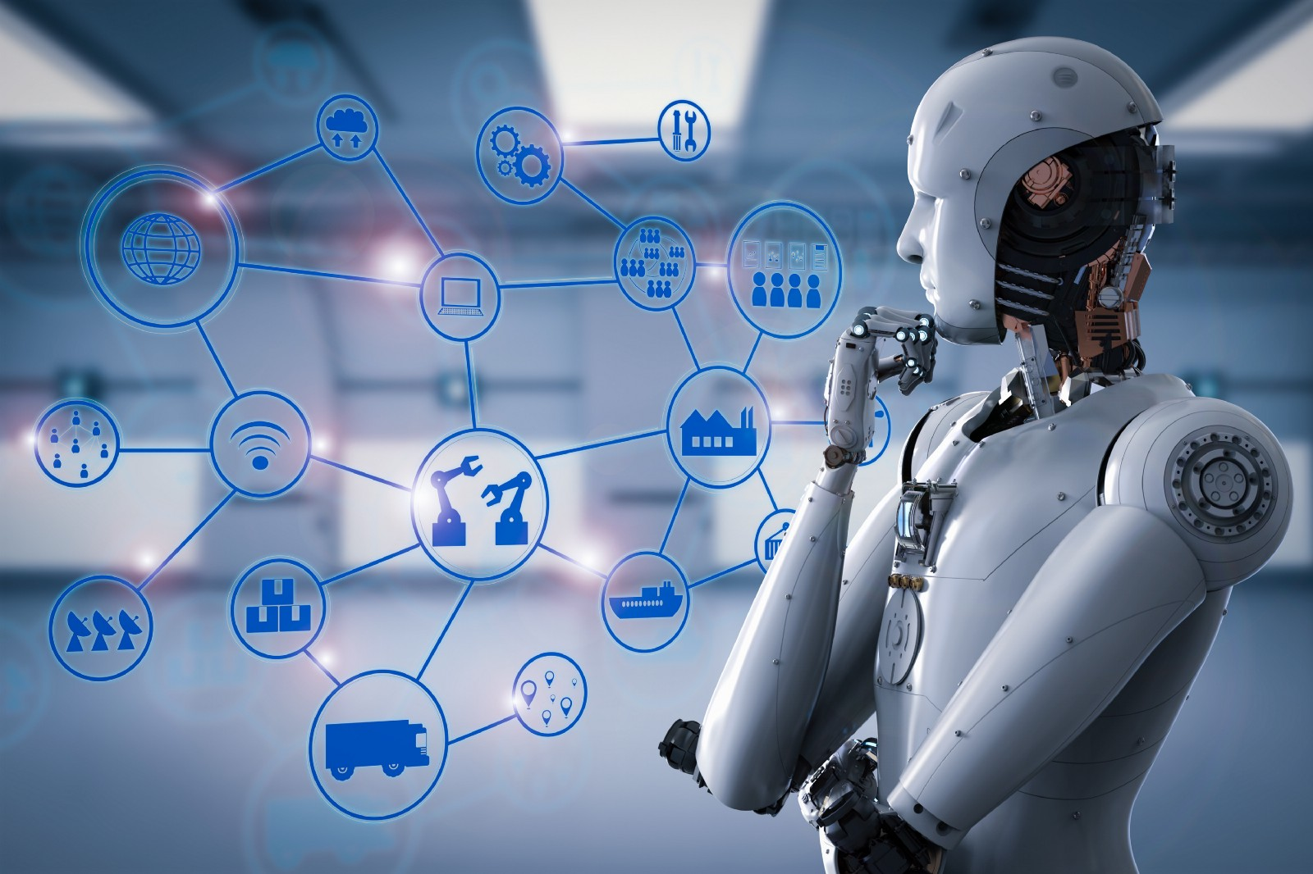
Notes:
Self explanation.

Slide 2
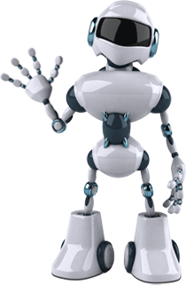
Agenda
1
What is Machine Learning?
2
Features of Machine Learning
3
Future of Machine Learning
4
5
6
7
Biggest Confusion: AI vs ML vs DL
How does Machine Learning Work?
Types, Algorithms & Examples of ML
Why the people are worried about AI?
8
Applications of Machine Learning
9
Market Trend of Machine Learning
10
Open source library of Machine Learning
11
Recommended way to get started
12
Which jobs will be replaced with AI?
Notes:
Self explanation.

Slide 3
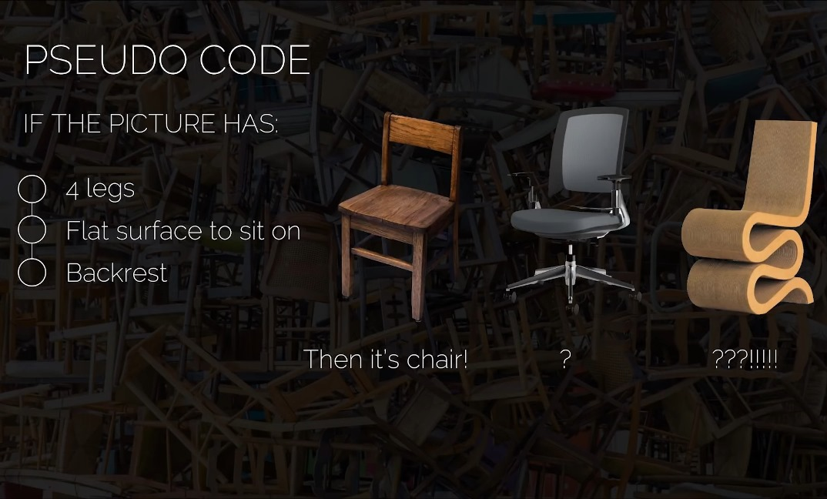
Notes:
Self explanation.

Slide 4
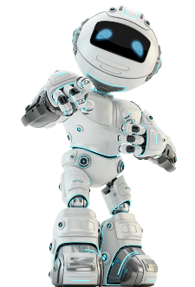
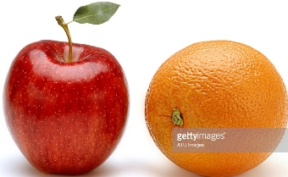
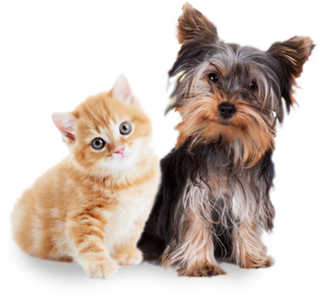
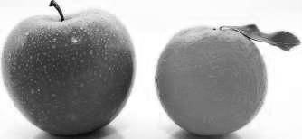
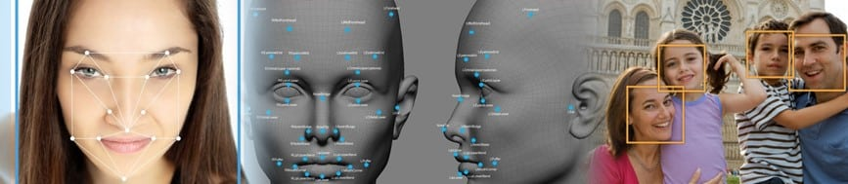
It is very hard to write programs that solve problems like:
Apple or Orange
Dog or Cat
recognizing a face
Notes:
Self explanation.

Slide 5
Rules
Traditional Programming
Answers
Data
Answers
Machine
Learning
Rules
Data
Notes:
Self explanation.

Slide 6
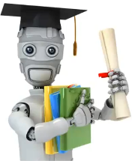
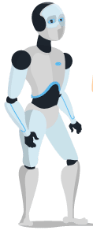
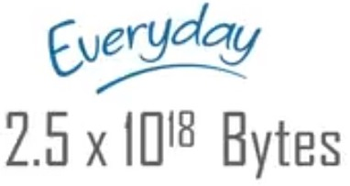
What is Machine Learning?
Machine learning is
learning from examples
and experience
Notes:
What is Machine Learning?
Well, Machine Learning is a concept which allows the machine to learn from examples and experience, and that too without being explicitly programmed. So instead of you writing the code, what you do is you feed data to the generic algorithm, and the algorithm/ machine builds the logic based on the given data.
Google says "Machine Learning is the future," and the future of Machine Learning is going to be very bright. As humans become more addicted to machines, we’re witnesses to a new revolution that’s taking over the world, and that is going to be the future of Machine Learning.
Here examples means data
Every day 2.5 Exabytes (or 250 crores gigabytes) , this boost the ml & ai

Slide 7
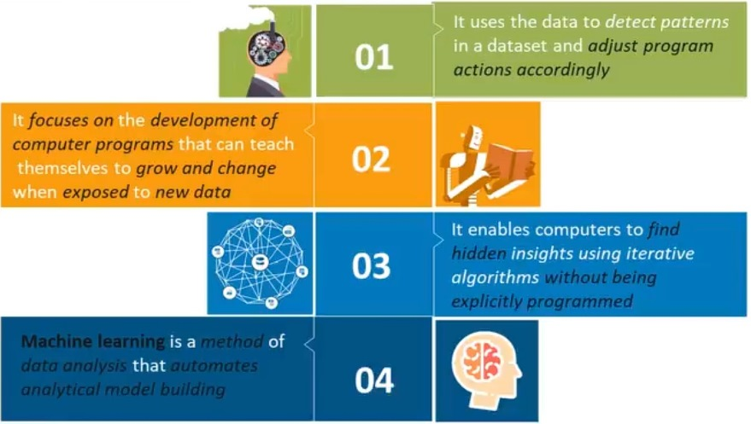
Features of Machine Learning
Notes:
Features of Machine Learning
It uses the data to detect patterns in a dataset and adjust program actions accordingly
It focuses on the development of computer programs that can teach themselves to grow and change when exposed to new data.
It enables computers to find hidden insights using iterative algorithms without being explicitly programmed
Machine learning is a method of data analysis that automates analytical model building

Slide 8
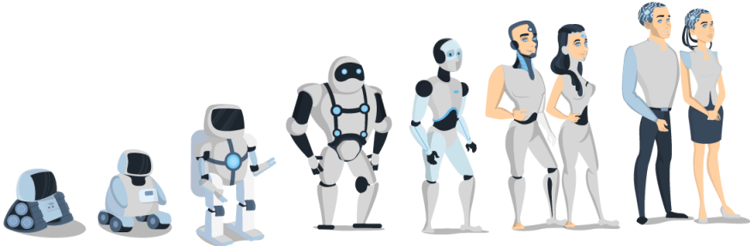
Future of Machines
In today’s world, these machines or the robots have to be programmed before they start following your instructions. But what if the machine started learning on their own from their experience, work like us, feel like us, do things more accurately than us? These things sound fascinating, Right? Well, just remember this is just the beginning of the new era.
Notes:
Future of Machines
In today’s world, these machines or the robots have to be programmed before they start following your instructions. But what if the machine started learning on their own from their experience, work like us, feel like us, do things more accurately than us? These things sound fascinating, Right? Well, just remember this is just the beginning of the new era.
=>A normal human brain capable to storage 2.5 petabytes (or a million gigabytes)
wherein the machine do not have any limitation on their memory storage.

Slide 9
Biggest Confusion: AI vs ML vs DL
Artificial Intelligence
Programs with the ability to
learn and response like humans
Machine Learning
Algorithms with the ability
to learn without being
Explicitly programmed
Deep Learning
Collection of neural networks & simple trainable mathematical units, organized in layers, that work together to solve complicated tasks
Notes:
Biggest Confusion: AI vs ML vs DL
AI: programs with the ability to learn new things and response like human.
ML: Algorithms with the ability to learn without being explicitly programmed
Deep Learning: Neural Network are inspire by the human brain.
neurons -> a thing that holds a number specifically (o-1)
0 for black pixel and 1 for white pixel,
Number between the neurons called “Activation”
Play the neural_networks.mp4 video

Slide 10
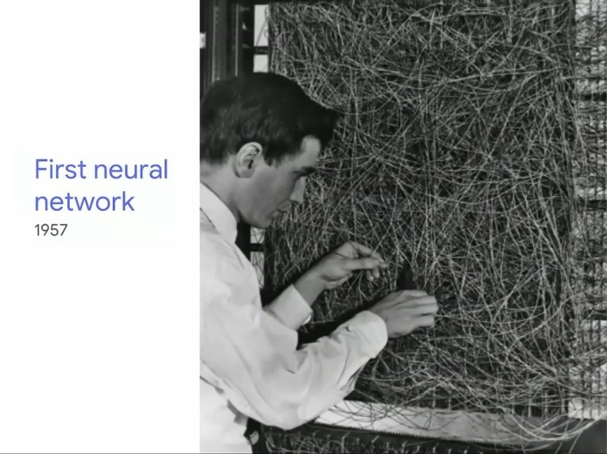
Notes:
First neural network
The first step toward artificial neural networks came in 1943 when Warren McCulloch, a neurophysiologist,
and a young mathematician, Walter Pitts, wrote a paper on how neurons might work.
They modeled a simple neural network with electrical circuits.

Slide 11
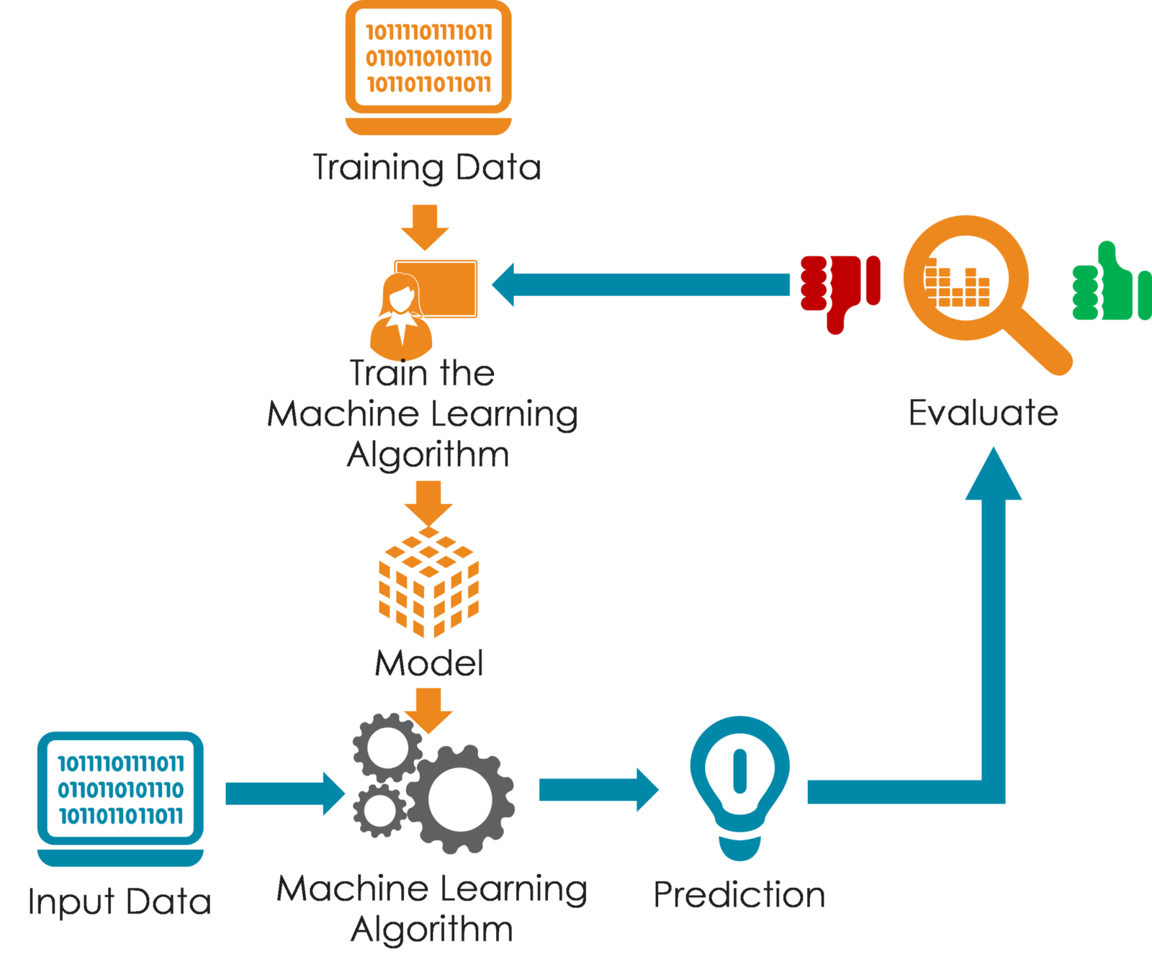
How does Machine Learning Work?
Notes:
Self explanation.
It’s a very high level of Machine Learning model.

Slide 12



Types of Machine Learning
Supervised
Unsupervised
Reinforcement
Notes:
Types of Machine Learning
Machine learning is sub-categorized to three types:
Supervised Learning – Train Me!
Unsupervised Learning – I am self sufficient in learning
Reinforcement Learning – My life My rules! (Hit & Trial)

Slide 13
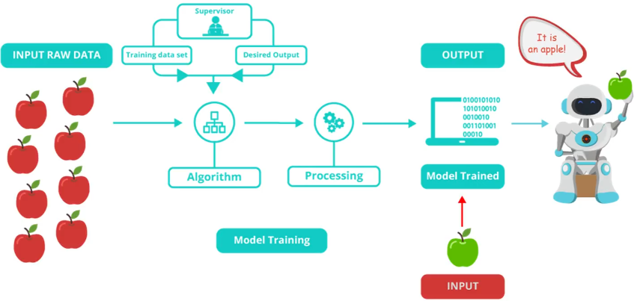
Supervised Learning
Train Me!
Labeled data
Direct feedback
Predict outcome/future
Notes:
What is Supervised Learning?
Supervised Learning is the one, where you can consider the learning is guided by a teacher. We have a dataset which acts as a teacher and its role is to train the model or the machine. Once the model gets trained it can start making a prediction or decision when new data is given to it.

Slide 14
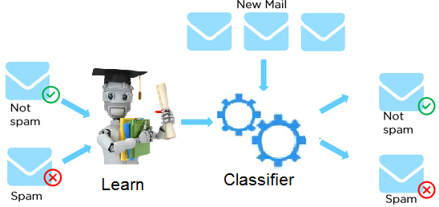
Example of Supervised Learning
An example of supervised learning using classification algorithms.
“How do email Spam Filters work? “
Dataset
Email | Label
Click here to claim your prize! | Spam
What’s new? | Not spam
Hang out later? | Not spam
You have won $1000,000 | Spam
… | …
Notes:
Self explanation.

Slide 15
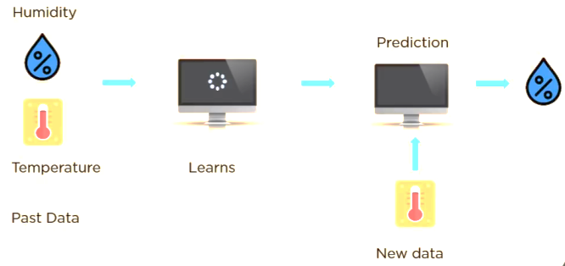
Example of Supervised Learning
An example of supervised learning using regression algorithms.
“Weather Prediction“
Dataset
Humidity | Temp.
Cloudy | 16
Sunny | 24
Rain | 10
Hot | 38
… | …
Notes:
Self explanation.

Slide 16
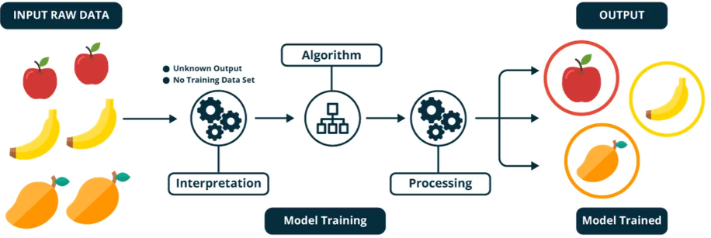
Unsupervised Learning
I am self sufficient in learning
No labels
No feedback
“Find hidden structure”
Notes:
What is Unsupervised Learning?
The model learns through observation and finds structures in the data. Once the model is given a dataset, it automatically finds patterns and relationships in the dataset by creating clusters in it. What it cannot do is add labels to the cluster, like it cannot say this a group of apples or mangoes, but it will separate all the apples from mangoes.
Suppose we presented images of apples, bananas and mangoes to the model, so what it does, based on some patterns and relationships it creates clusters and divides the dataset into those clusters. Now if a new data is fed to the model, it adds it to one of the created clusters.

Slide 17
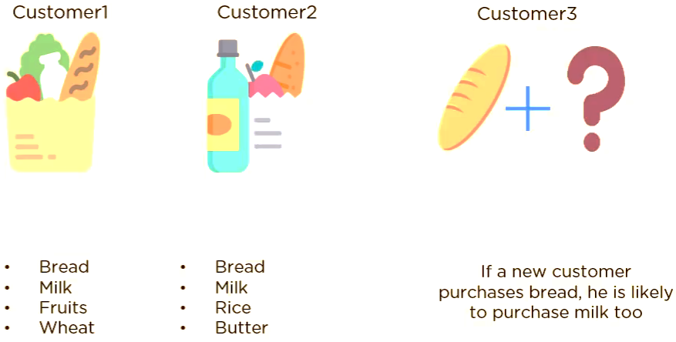
Example of Unsupervised Learning
Here is one example of unsupervised learning using association algorithm.
“Market basket or Recommendation system “
Notes:
Self explanation.

Slide 18
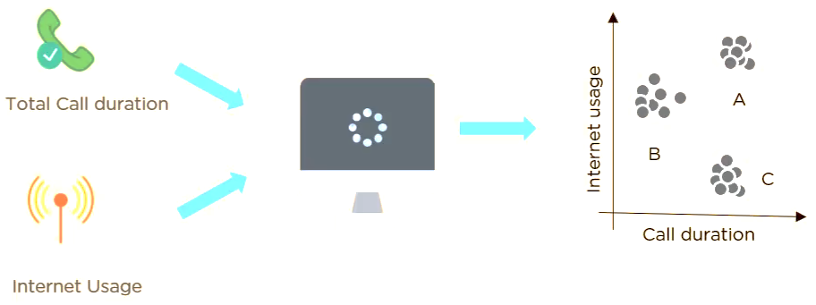
Example of Unsupervised Learning
Here is one example of unsupervised learning using clustering algorithm.
“Suppose a telecom company wants to reduce its customer churn rate by
providing personalized call and data plans“
Notes:
Self explanation.

Slide 19
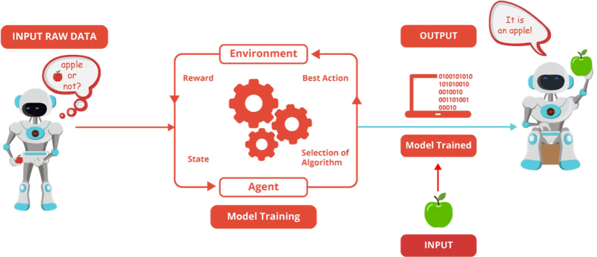
My life My rules! (Hit & Trial)
Decision process
Reward system
Learn from series of
actions/mistakes
Reinforcement Learning
Notes:
What is Reinforcement Learning?
It is the ability of an agent to interact with the environment and find out what is the best outcome. It follows the concept of hit and trial method. The agent is rewarded or penalized with a point for a correct or a wrong answer, and on the basis of the positive reward points gained the model trains itself. And again once trained it gets ready to predict the new data presented to it.

Slide 20
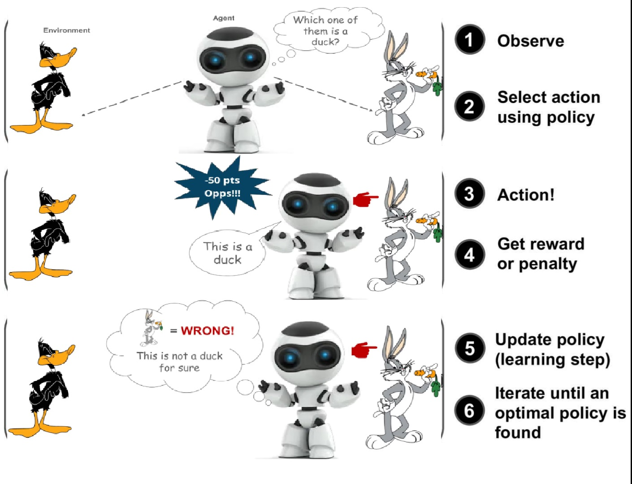
Example of Reinforcement Learning
Here is one example of reinforcement learning.
Notes:
Example of Reinforcement Learning
AlphaGo
In March 2016, it beat Lee Sedol in 4/5 game match.
In 2017, its beat Ke Jie, the world No. 1 Ranked player in 3/3 game match.

Slide 21
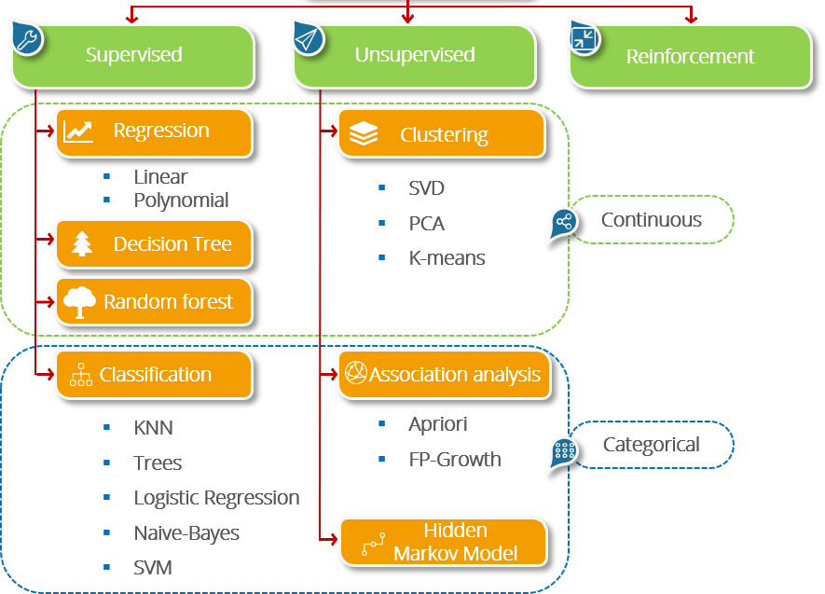
Algorithms of Machine Learning
Notes:
Algorithms of Machine Learning
Some of the most popular machine learning algorithms are:
In Supervised: Linear Regression, Decision Tree, Random forest & Classification KNN
In Clustering, Association analysis & Hidden Markov Model

Slide 22
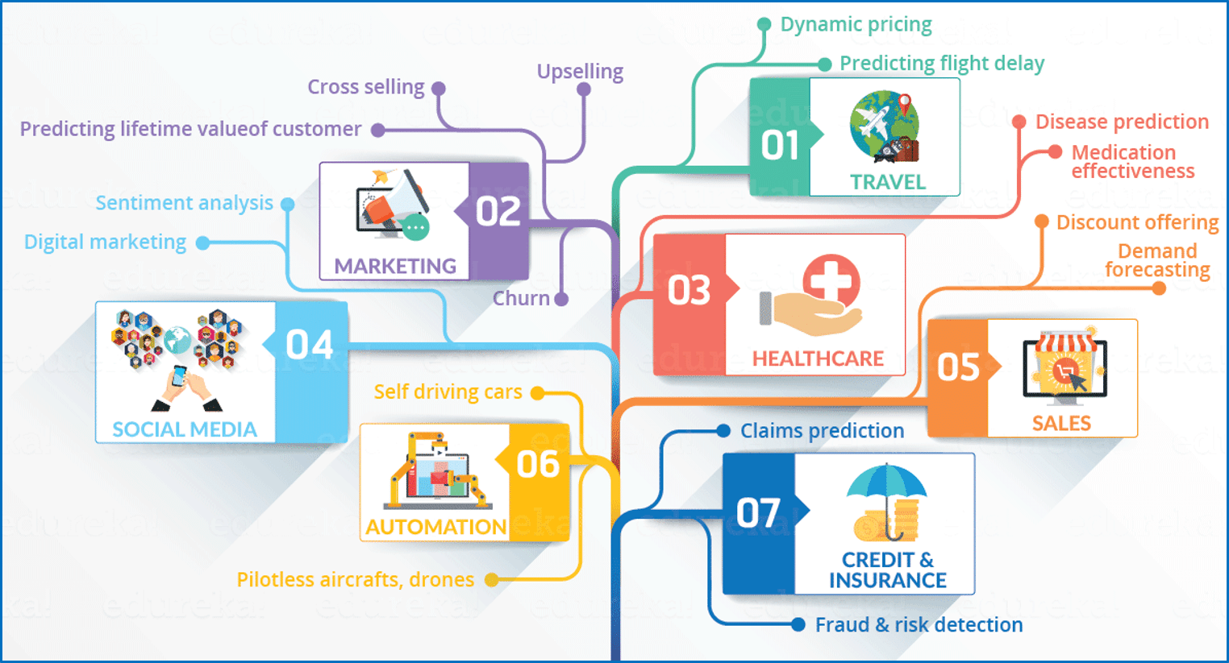
Applications of Machine Learning
Notes:
Applications of Machine Learning
Travel: Dynamic pricing (uber or ola)
Marketing:
Healthcare: Detecting Breast Cancer & Eye dieses.
Social Media: Digital Marketing
Sales: Discount offering & Demand forecasting
Automation: Self driving car, pilotless aircraft & drones
Credit & Insurance: fraud detection & claim prediction
Play the drones video

Slide 23
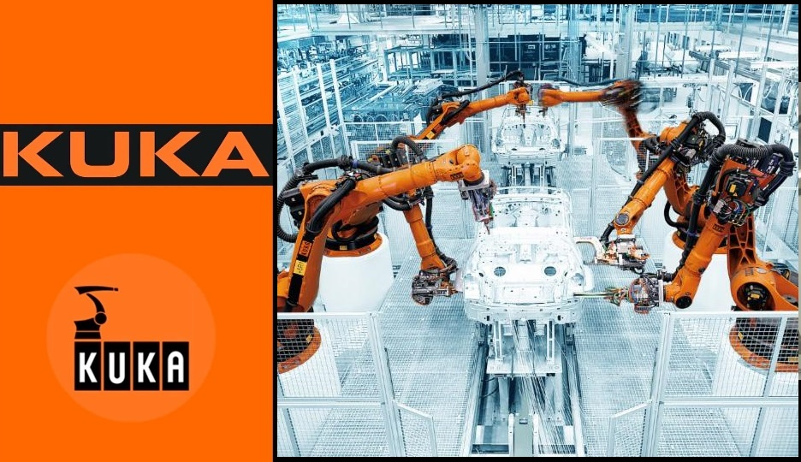
Notes:
Self-explanation.
Play the KUKA Videos

Slide 24
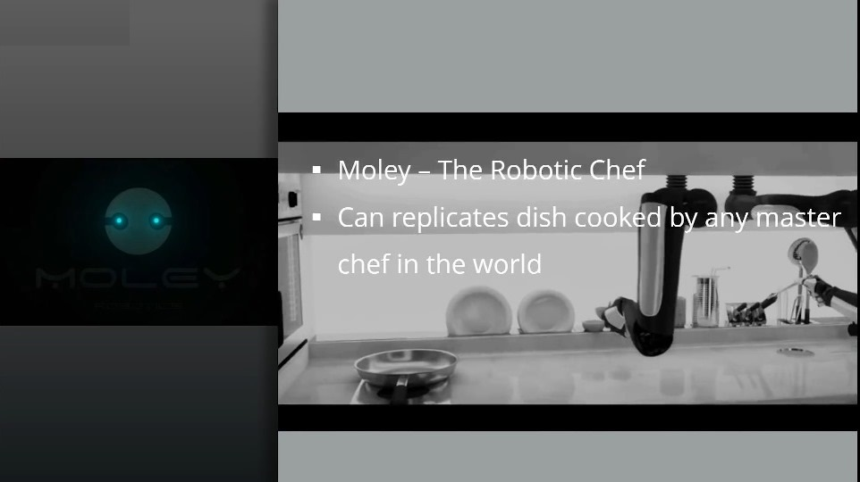
Notes:
Self explanation.
Play the moley Video

Slide 25
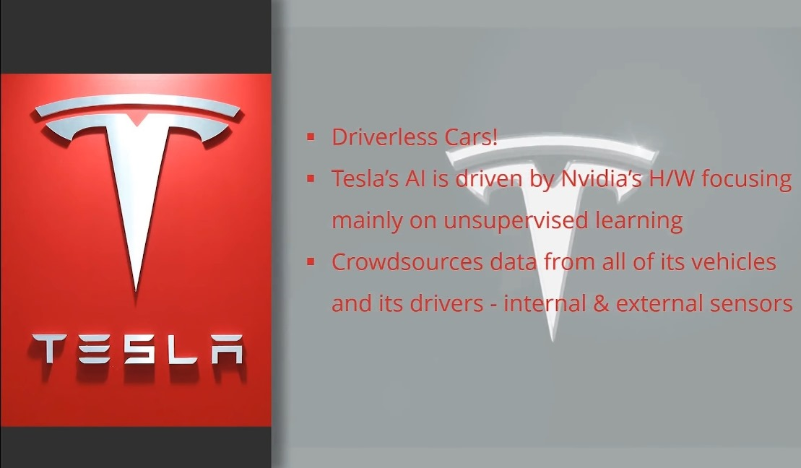
Notes:
Self explanation.
Play the TESLA Video

Slide 26
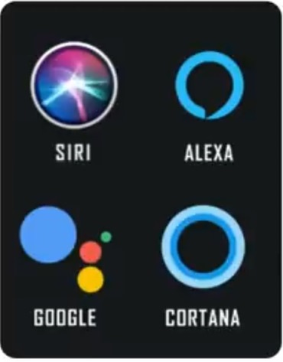
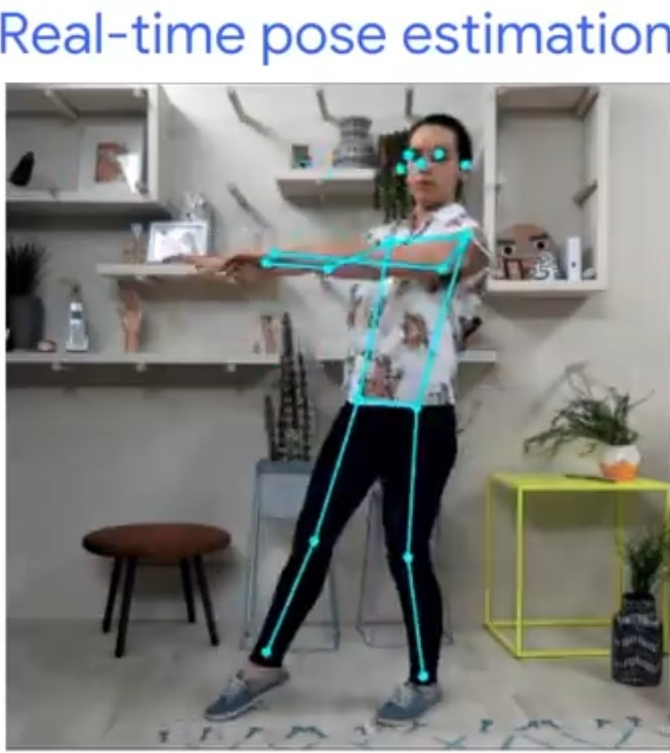
AI Assistants
Real-time pose estimation
Notes:
Make me a haircut appointment on Tuesday morning anytime between 10 to 12
Play the Google Duplex Video

Slide 27
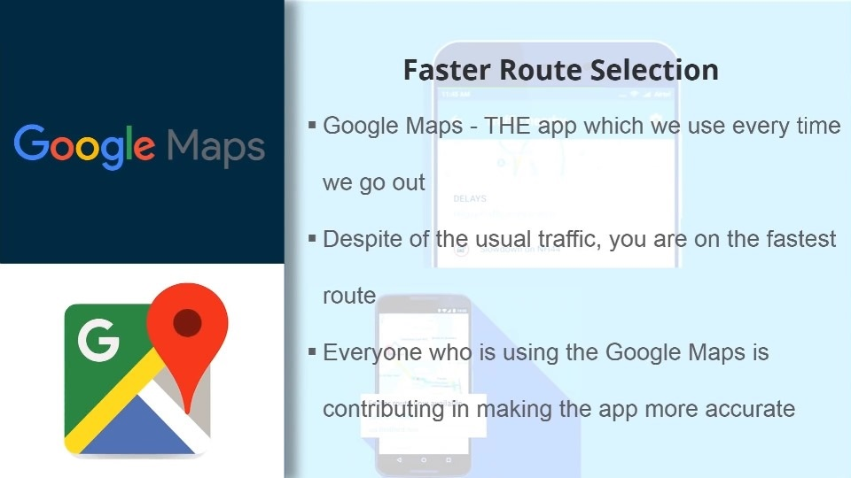
Notes:
Faster Route Selection
Google Maps- The app which we use every time we go out.
Despite of the usual traffic, you are on the fastest route.
Everyone who is using the Google Maps is contributing in making the app more accurate

Slide 28
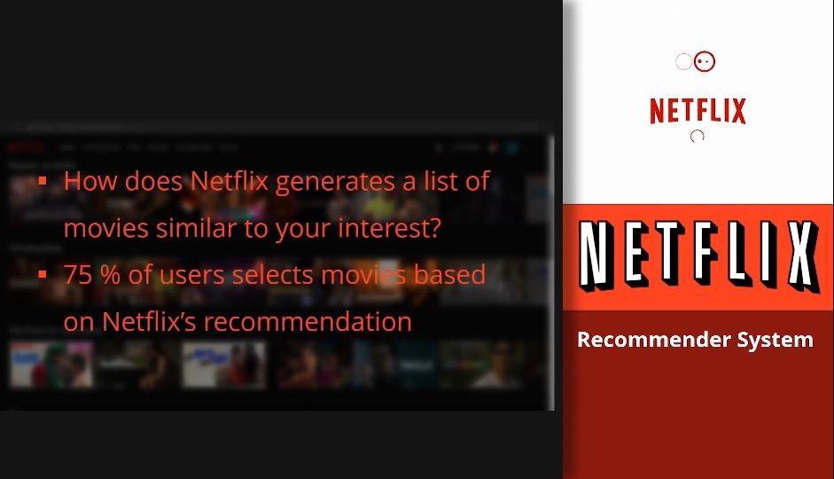
Notes:
How does Netflix generates a list of movies similar to your interest?
75% of users selects movies based on Netflix’s Recommendation

Slide 29
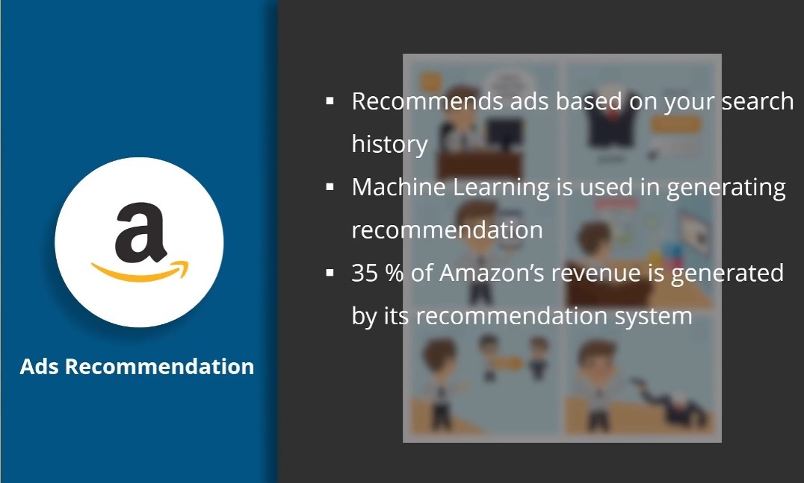
Notes:
Recommends ads based on your search history
Machine learning is used in generating recommendation
35% of Amazon’s revenue is generated by its recommendation system

Slide 30
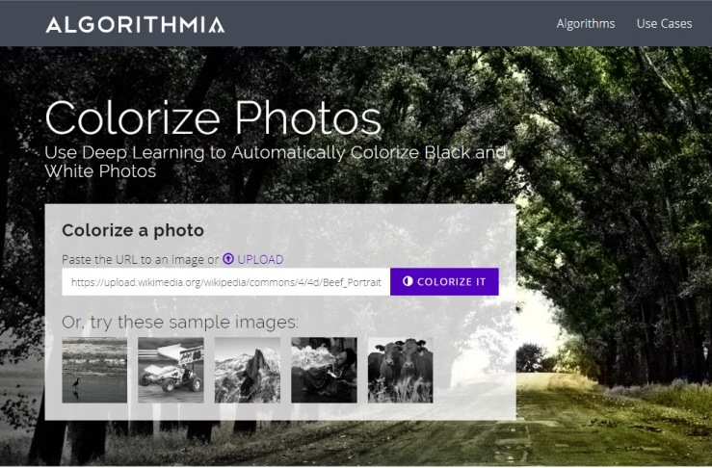
Notes:
Self-explanation.

Slide 31
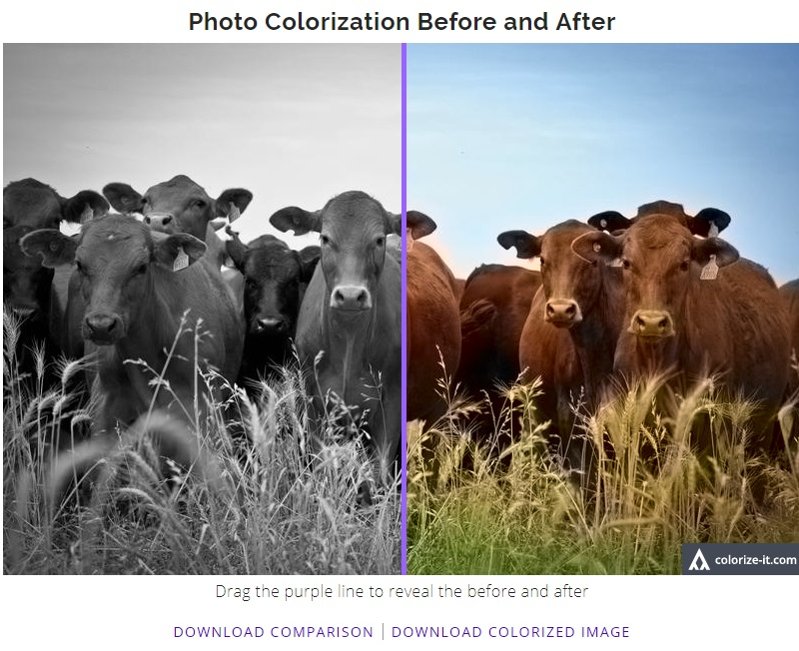
Notes:
Self-explanation.

Slide 32
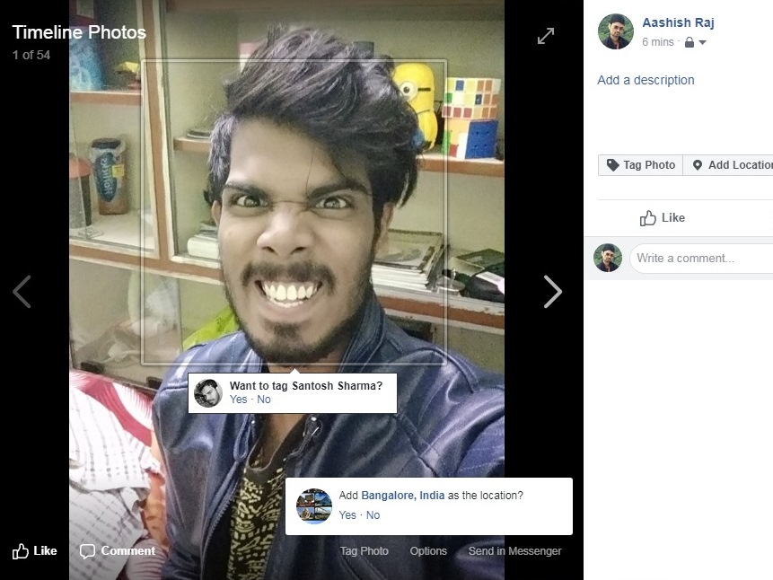
Notes:
Self-explanation.

Slide 33
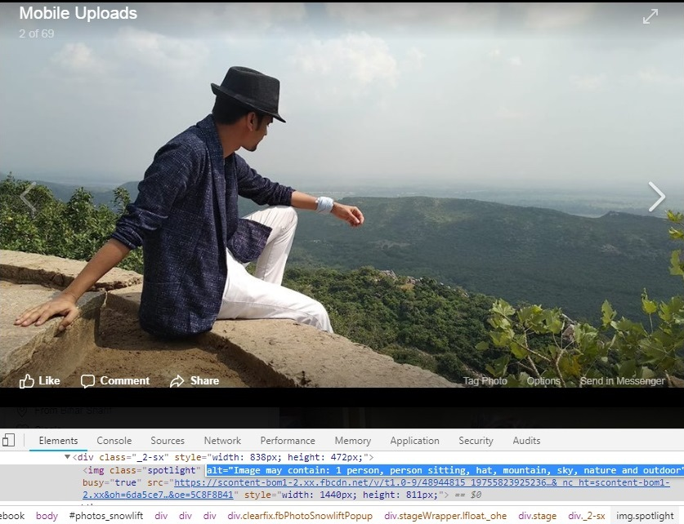
Notes:
Self-explanation.

Slide 34

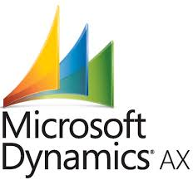


Examples of CRM with AI & ML
It’s no surprise that some of the biggest names in CRM Companies like:
have all integrated some form of AI into their platforms over the last few years.
Notes:
Examples of CRM with AI & ML
It’s no surprise that some of the biggest names in CRM Companies like: Salesforce, SugarCRM, Zoho and MicroSoft have all integrated some form of AI into their platforms over the last few years.
Play the Salesforce video
Salesforce: Salesforce’s AI tool is called Einstein. Billed as a tool that “… is a layer of artificial intelligence that delivers predictions and recommendations based on your unique business processes and customer data.”
Einstein can be integrated into every facet of the Salesforce CRM platform. It will cost businesses an additional $50 per user, per month.
Play the SugarCRM video
SugarCRM: SugarCRM has recently launched an AI product called Hint. Their pitch is that with just a name and email address, “Hint automatically searches, tunes, and inputs helpful personal and corporate profile details about your prospect. Results appear in seconds.”
Enabling Hint will cost SugarCRM users an additional $15 per user, per month.
Play the ZIA video
Zoho: Zoho offers a “conversational AI assistant” called Zia. Similar to the voice assistants built into most smartphones, but focused on CRM, “Zia is here to assist with everything from simple data to complex analytics. Talking to Zia is as simple as chatting with her from the bottom of your desktop screen, or calling her from your mobile app.”
Zia Voice is only included in Zoho CRM plans at the two highest tiers, which start at $35 per user, per month.
Play the layout video
Microsoft: No sooner did we publish this post than Microsoft announcednew AI and mixed reality business applications for Microsoft Dynamics.

Slide 35
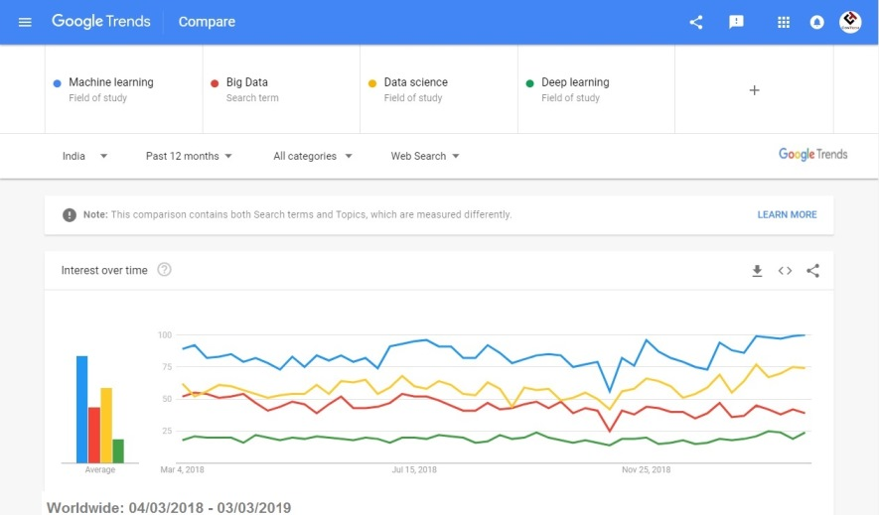
Market Trend: Machine Learning
Notes:
Self-explanation.

Slide 36




Open Source Libraries for Machine Learning
Notes:
TensorFlow:
An open source machine learning framework for everyone.
since TensorFlow is open source there are a lot additional language choices communities support being added all the time
TensorFlow since it's release (First released Nov 2015)
#1 repository in "machine learning" category on GitHub
Great for Deep Learning in particular
Standard software for general machine learning.
Concept heavy, but code light. many parameters, but good defaults. Only a few are important to adjust.
TensorFlow is a fast, flexible, and scalable open-source machine learning library for research and production.
Keras:
Keras is a high-level neural networks API, written in Python and capable of running on top of TensorFlow
Scikit-learn:
Scikit-learn is a free software machine learning library for the Python programming language. It features various classification, regression and clustering algorithms including support vector machines, random forests, gradient boosting & k-means
Python:
if you are interested you can try out TensorFlow in probably everyone favorite language right now Python 3

Slide 37
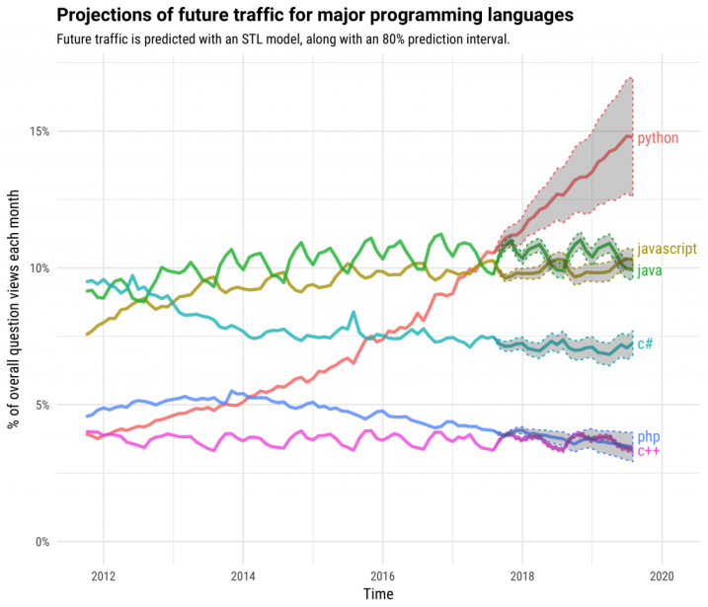
Notes:
Self-explanation.

Slide 38
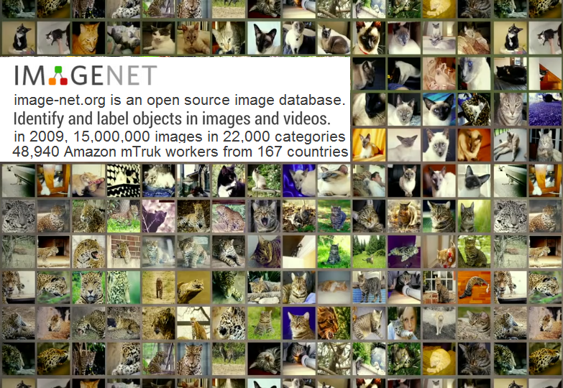
Notes:
IMAGENET
Imagenet is an open source image database.
Identify and label objects in images and video
since it's launch in 2009 having 15M images & 22,000 categories.
they use crowd sourcing technology like Amazon Mechanical Turk platform
48,940 workers from 167 countries is around the world,
help them to clean sort & label those images
which becomes rocket fuel for the ML engine.
as an eg in the case of cats
they have more than 62,000 cats of all kinds of looks, poses and the across all species of domestic and wild cats

Slide 39
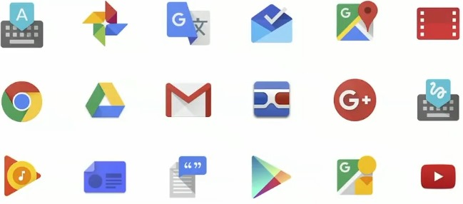
Growing use of Machine Learning at Google
Notes:
Self-explanation.

Slide 40
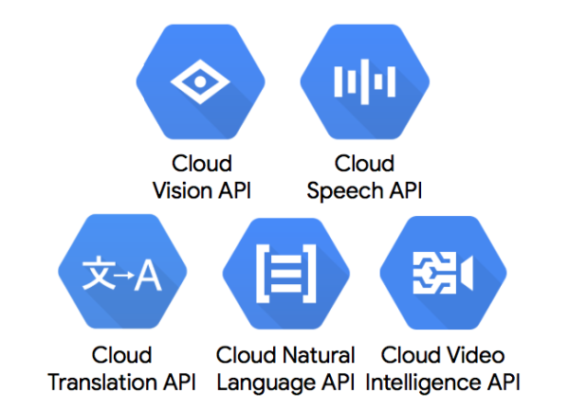
Google API to use Machine Learning models
Notes:
Self-explanation.

Slide 41
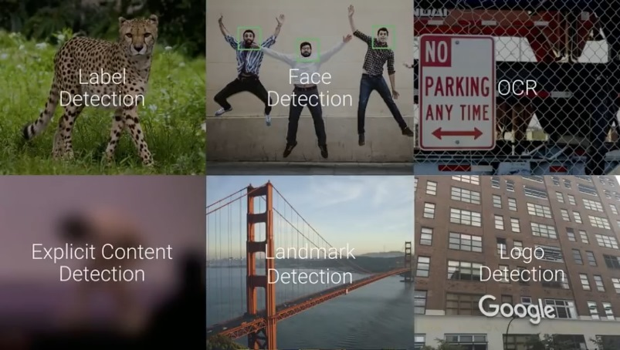
Cloud Vision API
Here you can try this API :
https://cloud.google.com/vision/
Notes:
Self-explanation.

Slide 42
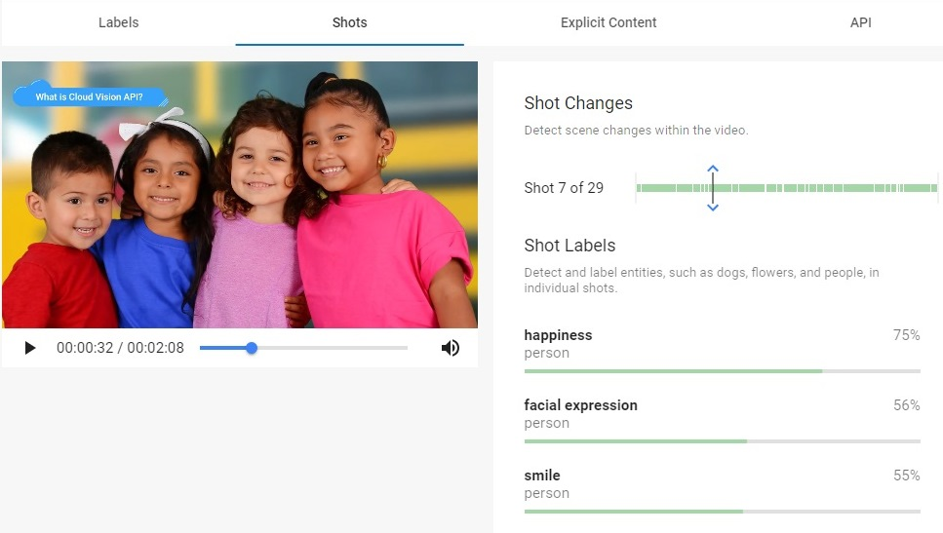
Cloud Video Intelligence API
Here you can try this API :
https://cloud.google.com/video-intelligence/
Notes:
Self-explanation.

Slide 43
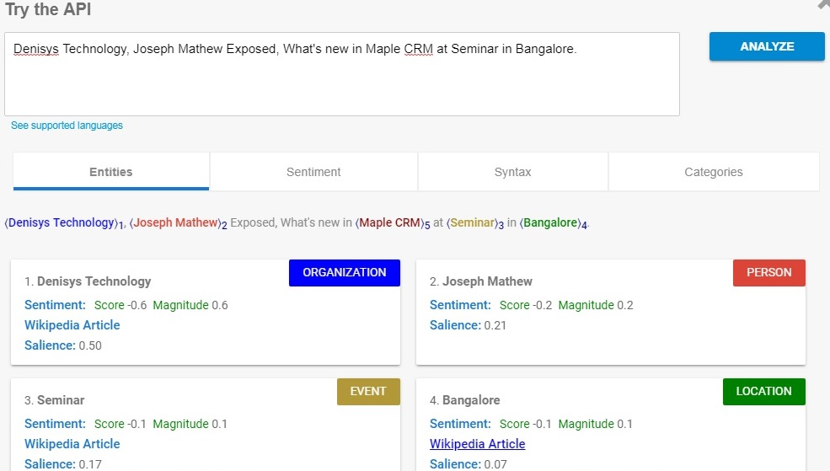
Cloud Natural Language API
Here you can try this API :
https://cloud.google.com/natural-language/
Notes:
Self-explanation.

Slide 44
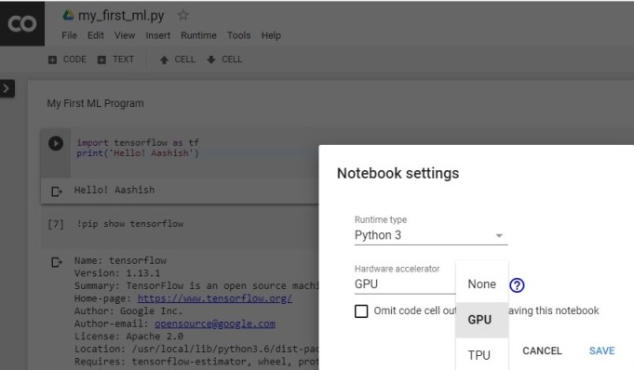
Recommended way to get started
Tutorials and code
Deep Learning with TensorFlow
tensorflow.org
Udacity class goo.gl/iHssII
Standford’s CS231n
Machine Learning Crash Course
cs231n.github.io
g.co/machinelearningcrashcourse
Google Colab
Code snippets on: github/tensorflow/workshops
Notes:
Self-explanation.

Slide 45
Which jobs will be replaced by AI?
Optimization
Creativity or Strategy
Repetitive
Tele-sales
Dishwasher
Customer Support
Routine
Hematologist
Security Guards
Car/Truck driver
Optimizing
Reporter
Radiologist
Research Analyst
Complex
CEO
Economist
ML & AI Expert
Creative
Artist
Scientist
Columnist
Optimization
Creativity or Strategy
Repetitive
Routine
Optimizing
Complex
CEO
Economist
ML & AI Expert
Creative
Artist
Scientist
Columnist
AI
AI
AI
5 Years
10 Years
15 Years
SAFE
SAFE
Notes:
Self-explanation.

Slide 46
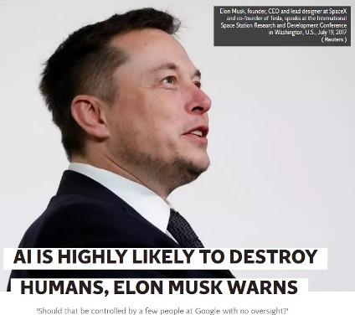
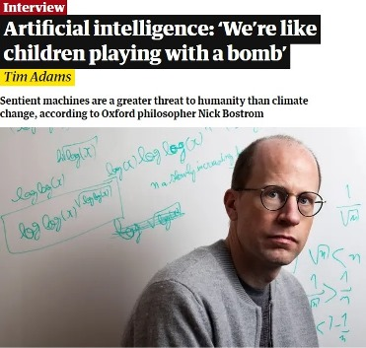
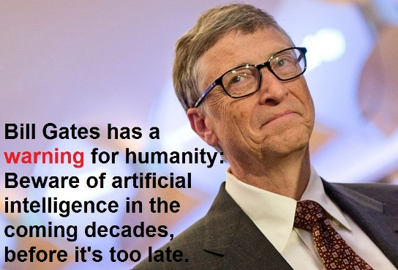
Why the people are worried about AI?
Stephen Hawking warns artificial intelligence could end mankind.
Notes:
Self-explanation.

Slide 47
Conclusion
=>AI is the new electricity… Just as 100 years
ago electricity transformed industry after
industry, AI will now do the same.
=>Artificial intelligence (AI) and machine
learning (ML) are coming of age.
=>Therefore, We have to ready with ML control
system in advanced, so that the machine
era will go up.
Notes:
Self-explanation.

Slide 48
Reference Material
https://cloud.google.com/products/ai/
https://trends.google.com/trends/
https://keras.io/
https://www.edureka.co/blog/what-is-machine-learning/
https://dzone.com/articles/future-of-machine-learning-why-learn-machine-learn
https://skymind.ai/wiki/machine-learning-algorithms/
https://www.crmswitch.com/crm-features/crm-artificial-intelligence/
https://demos.algorithmia.com/colorize-photos/
https://www.independent.co.uk/life-style/gadgets-and-tech/news/elon-musk-artificial-intelligence-openai-neuralink-ai-warning-a8074821.html
https://www.theguardian.com/technology/2016/jun/12/nick-bostrom-artificial-intelligence-machine
https://environmentaljusticetv.wordpress.com/2014/12/02/bbc-news-stephen-hawking-warns-artificial-intelligence-could-end-mankind/
https://steemit.com/steemit/@davidyakobovitch/where-is-data-science-trending-in-2018
https://playground.tensorflow.org/https://blogs.microsoft.com/blog/2018/09/18/announcing-new-ai-and-mixed-reality-business-applications-for-microsoft-dynamics/
Notes:
No explanation.

Slide 49







Aashish Kumar
Maple CRM Developer
aashishraj97
Slides, Videos & Code :
https://github.com/aashishraj97
Notes:
No explanation.

